Slide 1

Music Genre Classification
Rithika Nagarali
Rohan Maladkar
Nishi Jain
Priyanka Bhagwat
Ishika Banga
Project Guide: Amritansh

Slide 2

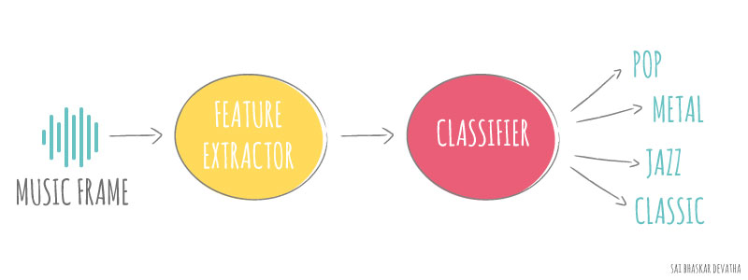
Introduction
Sound is represented in the form of an audio signal having parameters like frequency, decibel, bandwidth etc.
A Machine learning project to automatically classify different musical genres from audio files.
Classify these audio files using their low-level features of frequency and time domain.

Slide 3
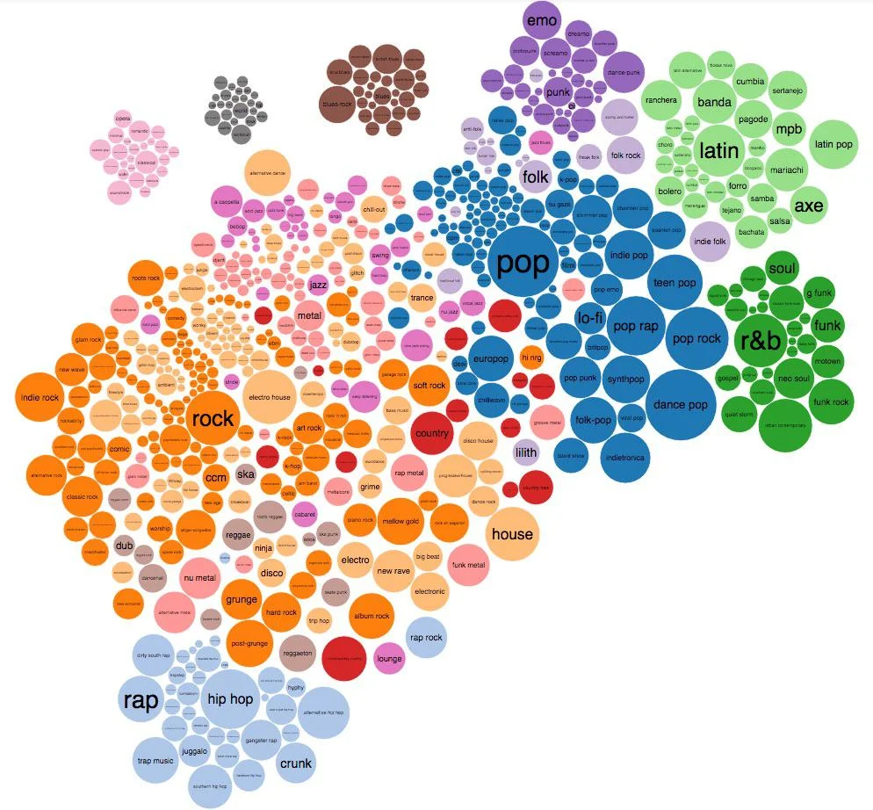
Why Classify Music?
Music genres are the best way for appreciating, comprehending and communicating with one another about the music we hear.
To understand music in a greater context.
To identify patterns in music.
To recommend a music.
To find music in our taste.
To enhance personal listening enjoyment.
To honor creative decisions of artists.

Slide 4
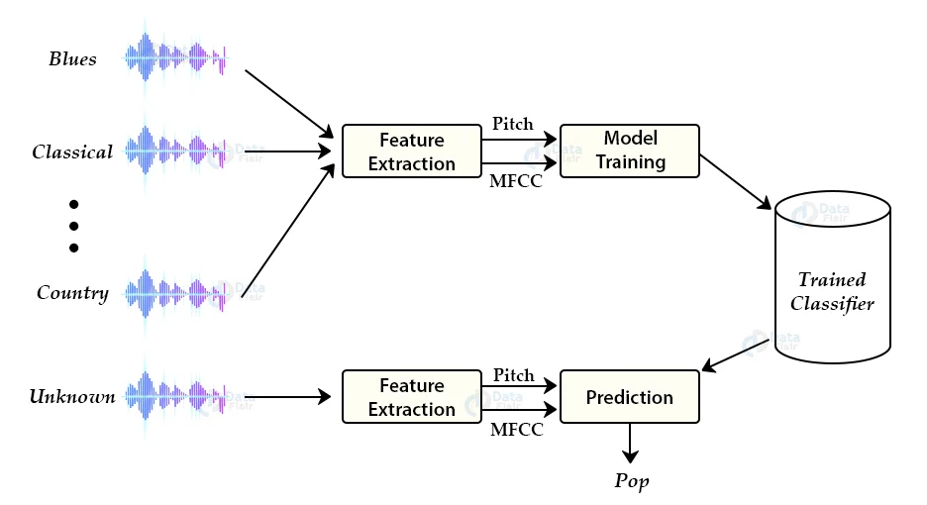
Workflow:
The work flow of the project

Slide 5
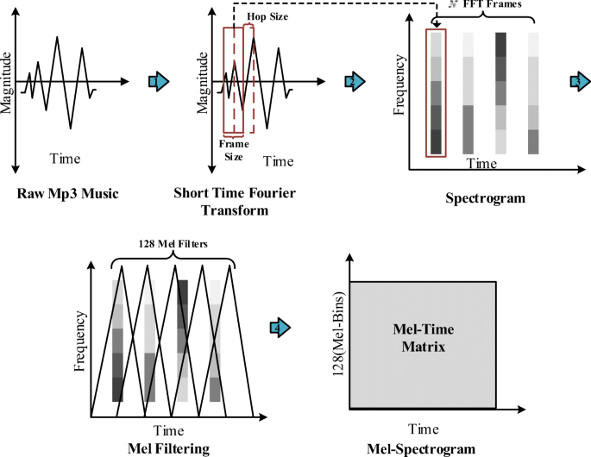
Methodology of Classification

Slide 6
Problem Statement
Music plays a very important role in people’s lives. Music bring like-minded people together and is the glue that holds communities together. Communities can be recognized by the type of songs that they compose, or even listen to. Different communities and groups listen to different kinds of music. One main feature that separates one kind of music from another is the genre of the music.
The aim of this project is:
1. To build a machine learning model which classifies music into its respective genre.
2. To compare the accuracies of this machine learning model and the pre-existing models, and draw the necessary conclusions.

Slide 7
Objectives of the Project
The objective of automating the music classification is to make the selection of songs quick and less cumbersome.
If one has to manually classify the songs or music, one has to listen to a whole lot of songs and then select the genre.
This is not only time-consuming but also difficult. Automating music classification can help to find valuable data such as trends, popular genres, and artists easily.
In recent times, music genre classification has become a very popular concept as more and more genres are emerging around the world.

Slide 8

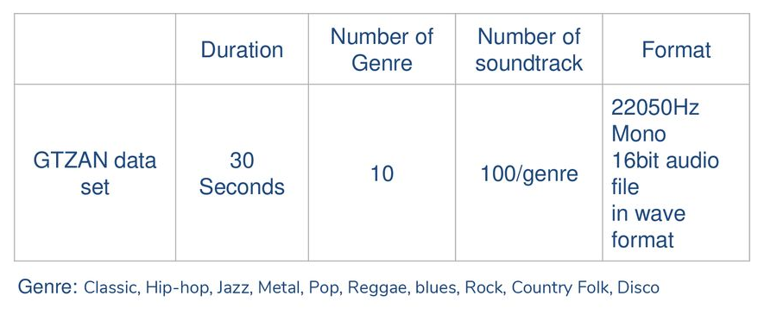
Dataset
Description

Slide 9
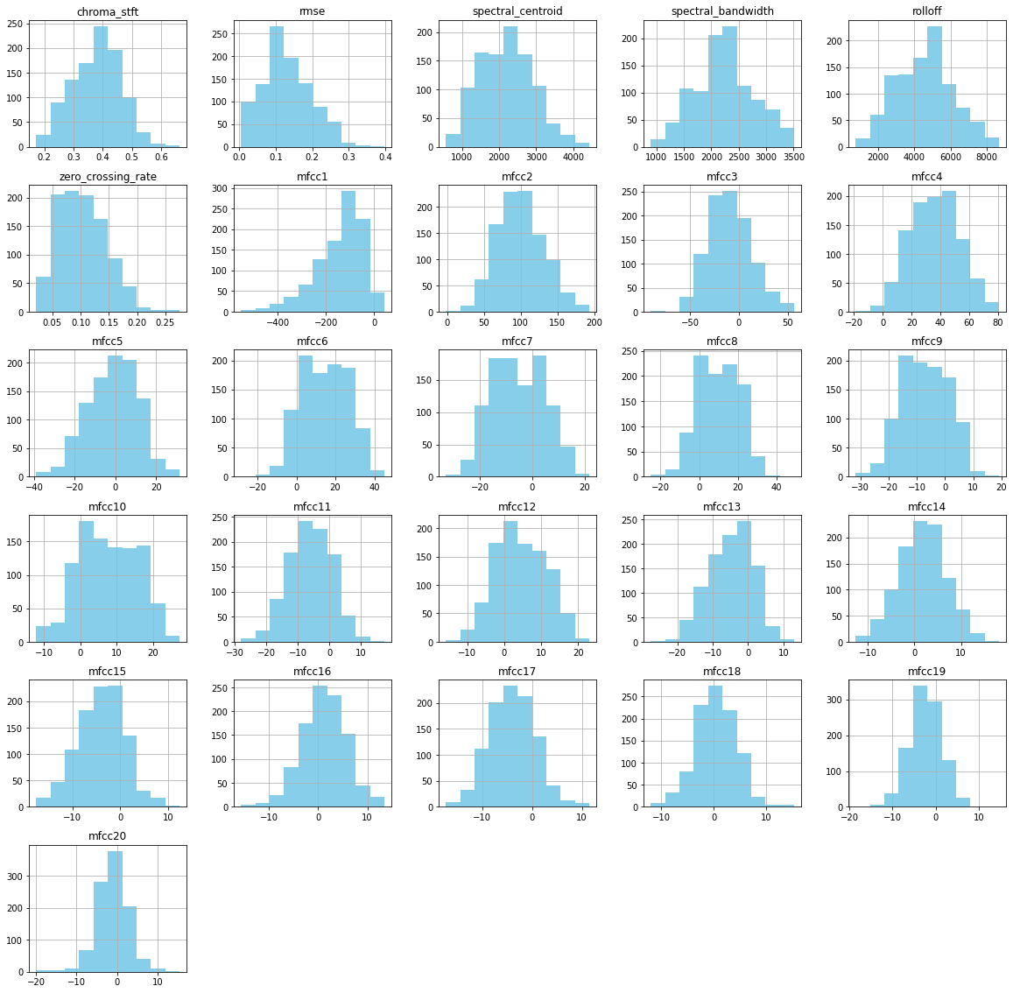
Data Visualizations: Histogram Plot of features.

Slide 10
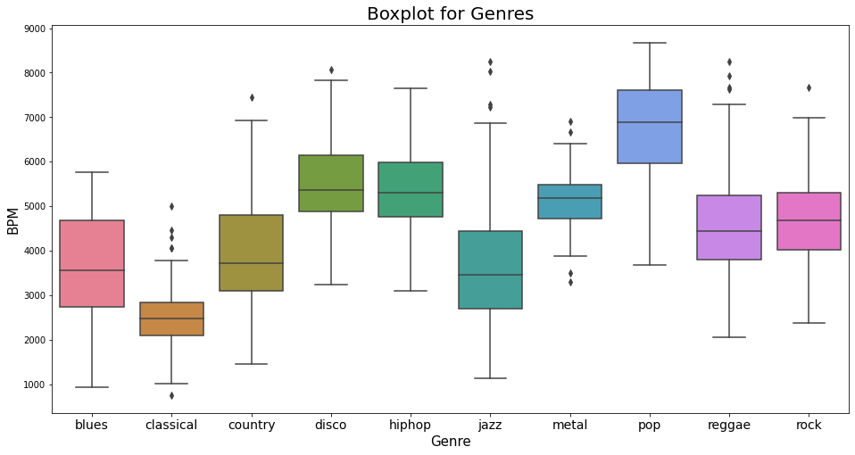
Box plot of BPM and Genre

Slide 11
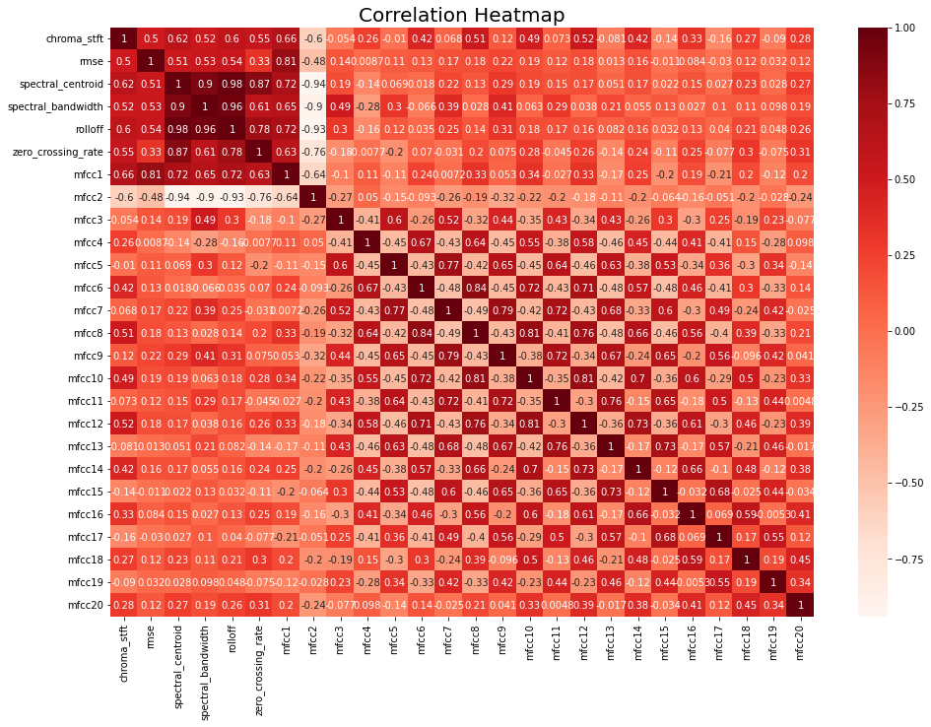
Correlation Heat Map

Slide 12
Models Approach
In this approach we will make use of several basic machine learning algorithms which are easy to understand and implement to create a model and then train and test it.
The algorithms we apply for our data set are:
1. kNN(k- Nearest Neighbors)
2. Logistic Regression
3. Random Forest
4. SVM (Support Vector Machine)

Slide 13
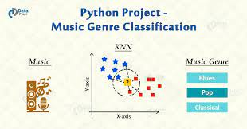
1.K-Nearest Neighbour Algorithm (KNN)
One of them, K-Nearest Neighbour (KNN),
is a technique that has been reportedly successful
in categorizing music into different genres.
The KNN algorithm, when implemented in music
genre classification, looks at similar songs and
assumes that they belong to the same category
because they seem to be near to each other.
One of the simplest ML techniques, the KNN algorithm
interprets data in a manner such that when the new data is fed, the machine automatically recognizes it and categorizes it as per the similarity of features.

Slide 14
2. Logistic Regression
Logistic Regression is a Machine Learning classification algorithm that is often used to predict the probability of a dependent variable; in our case we want to predict the genre of a given input song sample.
First of all, we need the logistic regression model and functions that we can import from the sklearn module.

Slide 15
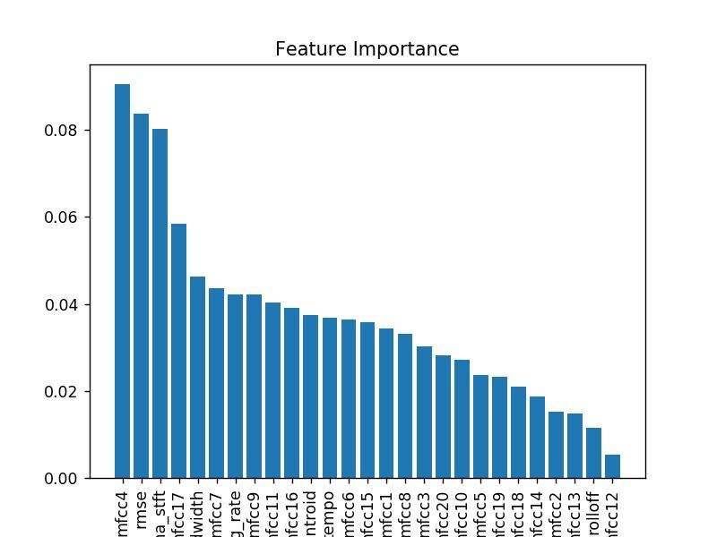
3.Random Forest
Random Forest is a ensemble learner that combines the prediction from a pre-specified number of decision trees.
It works on the integration of two main principles:
1) each decision tree is trained with
only a subset of the training samples
which is known as bootstrap aggregation
2) each decision tree is required to make its
prediction using only a random subset of the features.

Slide 16
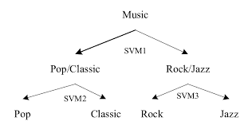
4. Support Vector Machine(SVM)
SVM is a supervised learning algorithm that
can be used in problems related to classification
and regression analysis.
A model of binary classification
in machine learning,
Since this method supports the classification
of data into 2 different classes, one can
incorporate the SVM technique to segregate songs into
2 music genres at a time.

Slide 17
Data Preprocessing
It is necessary to struggle with quality of data.
Noise data
Missing values
Our dataset contains 1000 records with no missing data in total.
No data reduction as our dataset is not too large.
No integration data since the conversion of sound recordings to features are done by different machines and algorithms.

Slide 18
Accuracy
Accuracy refers to the percentage of correctly classified test samples.
This approach evaluates how accurate the model's prediction is compared to the true data.
KNN model has the highest test accuracy. However, considering its higher training accuracy, there is still certain level of overfitting, even though feature selection and regularization are implemented.

Slide 19
Genre Classification Accuracy
Models | Test(%) | Train(%)
KNN | 73.36 | 55.3
Logistic Regression | 66.4 | 48.0
Random Forest | 56.3 | 59.2
SVM | 51.8 | 54.6
Decision Tree | 42.1 | 51.9
Let’s see the Implementation.

Slide 20
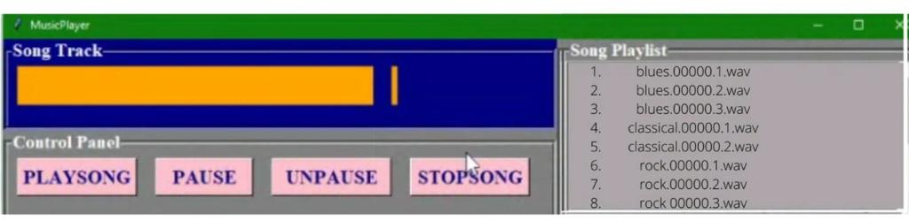
Results: Popup Window for Music Genre Classification

Slide 21
Conclusion and Future Scope
We implemented a variety of machine learning techniques to classify music genres using GTZAN dataset. The highest test accuracy is achieved by KNN with fine tuned parameters.
In real application, a new music track can turn into features the same way as we mentioned, and applied our machine learning models to predict its genre.
THANK YOU!

